Slide 1

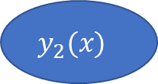

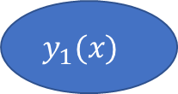



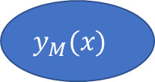

$$w_{1}^{n}$$
Weight
update
Dataset
$$y_{1}(x)$$
$$w_{2}^{n}$$
Vote
$$y_{2}(x)$$
$$…$$
$$…$$
$$w_{M}^{n}$$
Boosted model
$$y_{M}(x)$$
$$Y_{M}(x)=sign(\sum_{m}^{M}{α_{m}y_{m}(x)})$$
Weighted classifiers

Slide 2
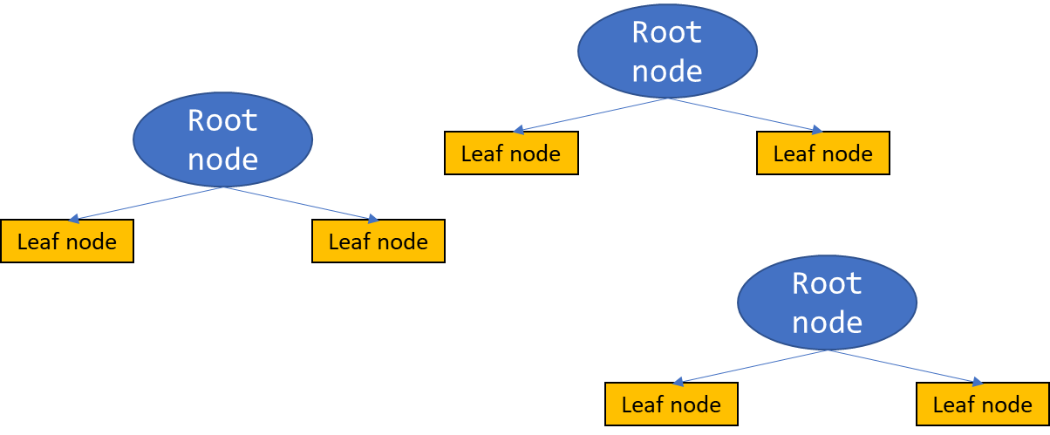
Dataset
Decision Stumps
…

